Slide 1
Course Topic Overview
+ Introduction To PowerShell
+ PowerShell Fundamentals
+ PowerShell Scripting
+ Leveraging PowerShell For Exploitation & Post Exploitation
+ AV Evasion & Obfuscation With PowerShell

Slide 2
1.1 Introduction To PowerShell

Slide 3
1.1 What IS PowerShell?
PowerShell is:
  A built-in Windows command-line & scripting language
  Available on almost all Windows systems
  Extremely powerful for administrators → which makes it perfect for post-exploitation

Slide 4
1.1 What IS PowerShell?
Most of the time, we’ll either be working with scripts commonly identified by the “.ps1” file extension, or through what are known as “Cmdlets ” (native Powershell commands) of which we can also create our own, and other times, we’ll be interacting directly with via the Powershell CLI.

Slide 5
1.2 Why Powershell?
+ Powershell is a powerful built-in shell and scripting
environment we can utilize as penetration testers
considering its wide-spread availability on all modern
Windows-based systems.

Slide 6
1.2 Why Powershell?
There are many advantages to using Powershell as it relates to penetration testing, with some of them being:
+ Many organizations aren’t actively hunting for Powershell activity
since it is usually considered a “trusted” application.
+ We can use Powershell to run, download or execute code, entirely
within the memory process of the Powershell executable, helping us evade endpoint security solutions.

Slide 7
1.3 The PowerShell CLI
+ In most cases, accessing the CLI is as
simple as just typing “powershell” in the
Windows search field from the Start
Menu.

Slide 8
1.3 The PowerShell CLI
+ In this case, the shortcuts are unavailable; the PowerShell executable itself can found in the “C:\Windows\System32\WindowsPowerShell\v1.0” directory.
+ If other versions are available on
the system, they can be found in
their corresponding version paths.

Slide 9
1.3 The PowerShell CLI
A note regarding 32-bit and 64-bit PowerShell executables:
+ If you’re operating on a 64-bit system, the location of the 64-bit PowerShell executable can be found in C:\windows\system32\WindowsPowerShell.
+ Whilethe 32-bit version being located in the C:\windows\SysWOW64\WindowsPowerShell directory.
+ This can be a bit confusing considering the directory naming convention.

Slide 10
1.3 The PowerShell CLI
A note regarding 32-bit and 64-bit PowerShell executables:
+ Nonetheless, we can determine whether we’re running in a 32-bit or 64-bit PowerShell environment from the CLI with the following command:
PS C:\> [Environment]::Is64BitProcess
+ Which should return “True” if the current PowerShell
process is 64-bit

Slide 11
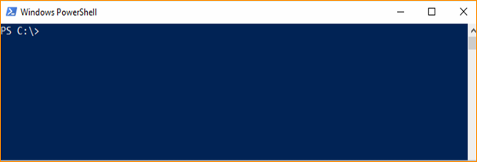
1.3 The PowerShell CLI
+ Once we launch PowerShell, we’re presented with the familiar blue console.

Slide 12
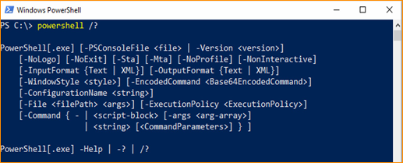
1.4 Basic Usage
+ Like most other programs found on Windows, the PowerShell executable has its own set of command line options. We can view these options with the usual “/?” help parameter:

Slide 13
1.4 Basic Usage
The following are some of the more common PowerShell.exe command line parameters we will use for our purposes:
-ExecutionPolicy
+ The PowerShell execution policy determines which scripts if any, we can run and can easily be disabled with the “Bypass” or “Unrestricted” arguments.
C:\> powershell.exe -ExecutionPolicy Bypass .\script.ps1
C:\> powershell.exe -ExecutionPolicy Unrestricted .\script.ps1

Slide 14
1.4 Basic Usage
-WindowStyle:
+ The -WindowStyleparameter hides the Powershell window when used with the “hidden” argument.
C:\> powershell.exe -WindowStyle Hidden .\script.ps1

Slide 15
1.4 Basic Usage
-Command:
+ The -Commandparameter is used to specify a Command or Script Block to run.
C:\> powershell.exe -Command Get-Process
C:\> powershell.exe -Command “& { Get-EventLog –LogName security }”

Slide 16
1.4 Basic Usage
-EncodedCommand:
+ The -EncodedCommandparameter is used to execute base64 encoded scripts or commands.
C:\> powershell.exe -EncodedCommand $encodedCommand

Slide 17
1.4 Basic Usage
-NoProfile:
+ Don’t load any powershell profiles.
+ Profiles are essentially scripts that run when the powershell executable is launched and can interfere with our operations.
C:\> powershell.exe -NoProfile .\script.ps1

Slide 18
1.4 Basic Usage
-Version:
We can use the -Versionparameter followed by a version number as the argument to downgrade the version of PowerShell.
+ Useful in scenarios where you’ve landed on a machine with a more recent version and need to downgrade to Version 1.0 or 2.0 or to complete certain tasks.
+ Requires that older versions are still installed on the target.
C:\> powershell.exe –Version 2

Slide 19
1.4 Basic Usage
+ Furthermore, all of the PowerShell.exe command line parameters, as well as their arguments, can also be abbreviated, as long as the abbreviations are unique, and additionally, are not required to be case-sensitive
either:
-ExecutionPolicy Bypass
powershell.exe -ep Bypass → powershell.exe -ex by
-EncodedCommand
powershell.exe –enco → powershell.exe –ec
-WindowStyle Hidden
powershell.exe –W h → powershell.exe –Wi hi

Slide 20
1.4 Basic Usage
+ An extremely useful feature of the PowerShell CLI is the “Get-Help” cmdlet.
+ Similar to *nix “Man Pages,” we can call upon the “GetHelp” command to obtain information related to any function, alias, module or cmdlet that PowerShell is aware of.
+ We can do this by including the cmdlet, function or module
name we’re looking for information on, as an argument to
the “Get-Help” cmdlet.

Slide 21
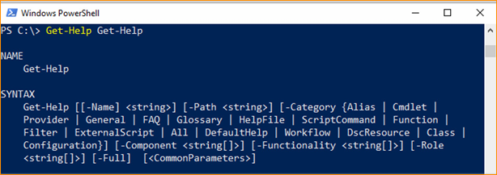
1.4 Basic Usage
+ We can see here that we’re requesting the PowerShell Help pages for the “Get-Help” cmdlet itself:

Slide 22
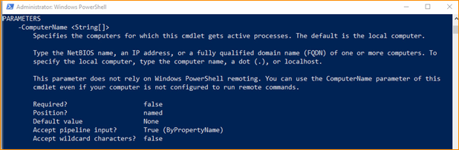
1.4 Basic Usage
+ To get “full” help for any cmdlet, which includes detailed information on associated parameters, we can use the Full parameter:
PS C:\> Get-Help Get-Process -Full

Slide 23
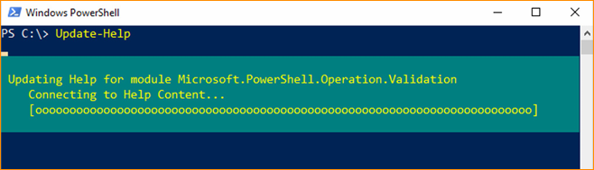
1.4 Basic Usage
+ If we’d like to update our locally installed help files for PowerShell via the CLI, we can do so with the “UpdateHelp” cmdlet:

Slide 24
1.4 Basic Usage
+ The “Get-Command” cmdlet is another very useful one.
+ It allows us to list all cmdlets, aliases, functions, workflows, filters, scripts and any applications that are available for us to use in PowerShell.

Slide 25
1.4 Basic Usage
+ Running the “Get-Command” cmdlet without arguments will simply list all commands, but we can also use the –Name parameter to list any that are useful to us.
+ For instance, we can list all functions related to modification of the Windows Firewall with the following command:
PS C:\> Get-Command –Name *Firewall*

Slide 26
1.5 Cmdlets
As we’ve seen in the previous section, cmdlets(“command-lets”) are a big part of how we will leverage PowerShell for our offensive purposes, two of which we’ve already briefly covered:
+ “Get-Help”
+ “Get-Command”

Slide 27
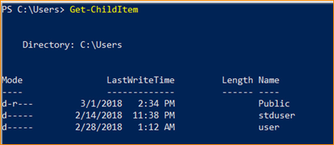
1.5 Cmdlets
+ For example, just running the “Get-ChildItem” cmdlet without any other arguments or options, returns four columns named “Mode,” “LastWriteTime,” “Length” and “Name”.

Slide 28
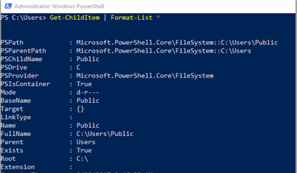
1.5 Cmdlets
+ But by piping the output of
a cmdlet to the “Format
List” cmdlet, rather than
columns and names as
seen in the previous slide,
we can return all named
properties associated with
its objects
in a different
list-like format,
PS C:\> Get-ChildItem | Format-List *

Slide 29
1.6 Pipelining
+ The results of all cmdlet output, are usually referred to as “objects.”
+ These objects can be further processed using what is known as “pipelining,” similar to how we can chain commands together in a Linux bash shell for instance with the Pipe Operator (|).

Slide 30
1.6 Pipelining
+ An example of this processing of cmdlet output objects with pipelines would be something like the following:
PS C:\> Get-Process | Sort-Object -Unique | Select-Object ProcessName
+ The above returns a list of processes (Get-Process), then sorts the list (Sort-Object) with the (-Unique) parameter, and finally, selects the “ProcessName” objects (Select-Object ProcessName) and returns a unique list of process names.

Slide 31
1.7 Useful Cmdlets & Usage
+ Let’s now examine several examples of Cmdlet usage we’ll find useful for our work.

Slide 32
1.7 Useful Cmdlets & Usage
Get-Process
+ The Get-Process cmdlet will give us a listing of all processes, as we saw in a previous example.

Slide 33
1.7 Useful Cmdlets & Usage
Get-Process
+ The Get-Process cmdlet will give us a listing of all processes, as we saw in a previous example.
+ Running the “Get-Process” cmdlet without any arguments returns basic information as we can see, and is formatted in a table-like format, which includes column names (properties).

Slide 34
1.7 Useful Cmdlets & Usage
Get-ChildItem
+ Something that’s good to know about cmdlets is that most of them have “Aliases.” For instance, the “Get-ChildItem” cmdlet which simply lists items in a directory, can be alternatively called by issuing the “ls” command, which is an alias for the Get-ChildItem cmdlet.
+ To find what the aliases are for a specific cmdlet, we can use the “Get-Alias” cmdlet with the “-Definition” parameter followed by a cmdlet name, like in the following example:
PS C:\Users> Get-Alias -Definition Get-ChildItem

Slide 35
1.7 Useful Cmdlets & Usage
Get-WmiObject
+ Another alias you’ll see quite often is “select” when used in conjunction with other cmdlets in pipeline operations and is an alias for the “Select-Object” cmdlet.
+ In this example, we’re using the “Get-WmiObject” cmdlet, (used to return information about WMI objects) in conjunction with the “-class win32_operatingsystem” parameter and arguments, and then selecting (select) all (*) properties related to that WMI object class; this returns all information related to the current operating system.
PS C:\> Get-WmiObject -class win32_operatingsystem | select-Property *

Slide 36
1.7 Useful Cmdlets & Usage
Exploring the Registry
+ For access to Windows Registry hives, PowerShell provides a convenient method with the following command:
PS C:\> cd HKLM:\

Slide 37
1.7 Useful Cmdlets & Usage
Exploring the Registry
+ For access to Windows Registry hives, PowerShell provides a convenient method with the following command:
PS C:\> cd HKLM:\

