Slide 1


WELCOME TO
GETTING STARTED WITH JAVA
Muhammad Mousa AlBothom | +971543439118 |+962799677024 | m7mdbozom@gmail.com

Slide 2




Getting Started with Java
INTRODUCTION TO JAVA
Java is an Object-Oriented Programming (OOP) language that organizes code around data objects rather than actions. It uses classes, inheritance, and encapsulation for reusability and complex modeling. Every Java program must have at least one main class to run — typically named Main. All code in Java must be written inside a class.

Slide 3


Getting Started with Java
CLASS NAMING CONVENTIONS
Uppercase Class Names
01
Class names must start with an uppercase letter. This is a standard Java convention that improves code readability.
Case Sensitivity
Java enforces strict naming rules that ensure consistency and prevent errors. Understanding these conventions is essential for writing code that compiles and runs correctly.
02
Java is case-sensitive — MyClass and myclass are treated as completely different identifiers.
File Name Matching
03
The file name must exactly match the class name (e.g., Main.java for class Main).
Error Prevention
04
If the file name and class name don't match, Java will throw an error and the program won't run.

Slide 4

Getting Started with Java
THE MAIN METHOD – EXPLANATION
The main() method is the entry point of every Java program. Its syntax is: public static void main(String[] args). Any code written inside the main() method will be executed when the program runs. Think of main() as the starting point — without it, your Java program cannot run.

Slide 5
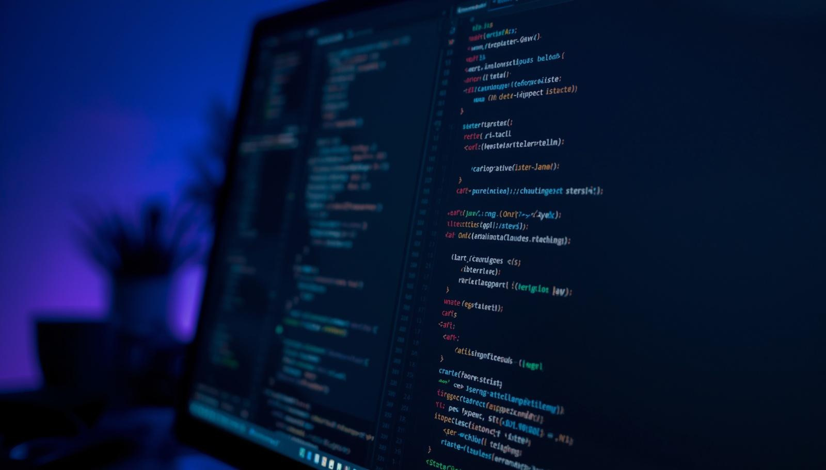
Getting Started with Java
THE MAIN METHOD – CODE EXAMPLE
public static void main(String[] args) {
System.out.println("Hello World");
}
This code prints "Hello World" to the console when the program runs. The main() method serves as the entry point for execution.

Slide 6
Muhammad Mousa AlBothom
PRINTING OUTPUT IN JAVA
System Class
out (Output Stream)
println() Method
System is a built-in Java class that provides access to system resources like input, output, and error streams.
out is a member of the System class that represents the output stream, directing text to the console display.
println() is the method that prints a line of text and moves the cursor to a new line after printing.
Use System.out.println() to print text to the screen. Each Java statement must end with a semicolon (;). Curly braces {} define the start and end of a code block.

Slide 7
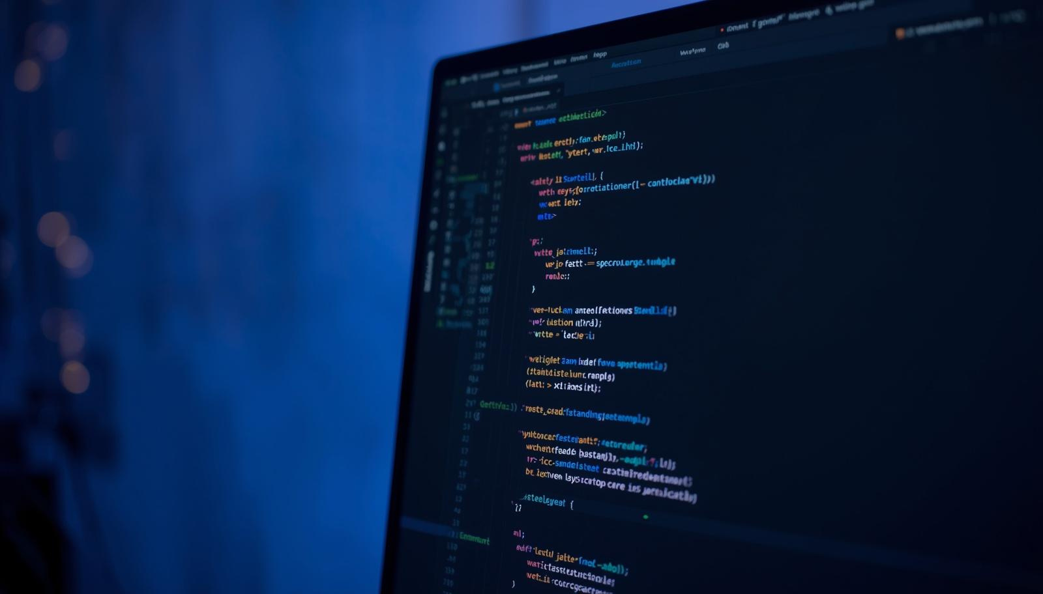
Getting Started with Java
PRINTING OUTPUT – CODE EXAMPLE
public static void main(String[] args) {
System.out.println("Hello World");
}
Components: System is a built-in Java class, out is the output stream, println() is the method that prints text and adds a new line, and the semicolon (;) terminates the statement.

Slide 8




Getting Started with Java
STATEMENTS IN JAVA
A statement is an instruction executed by the computer. Each statement must end with a semicolon (;). Forgetting the semicolon causes an error and your program won't compile. Java executes statements sequentially, from top to bottom.

Slide 9
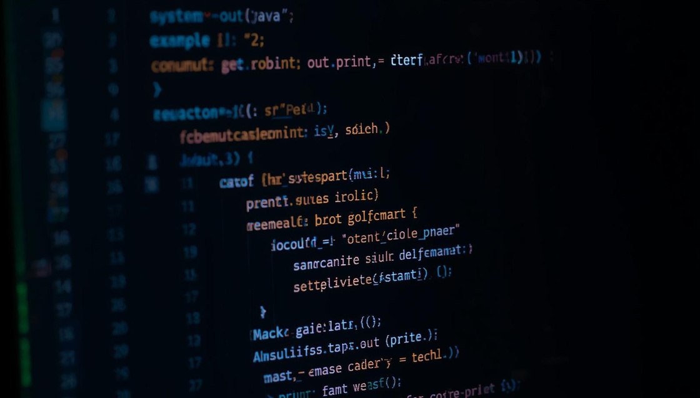
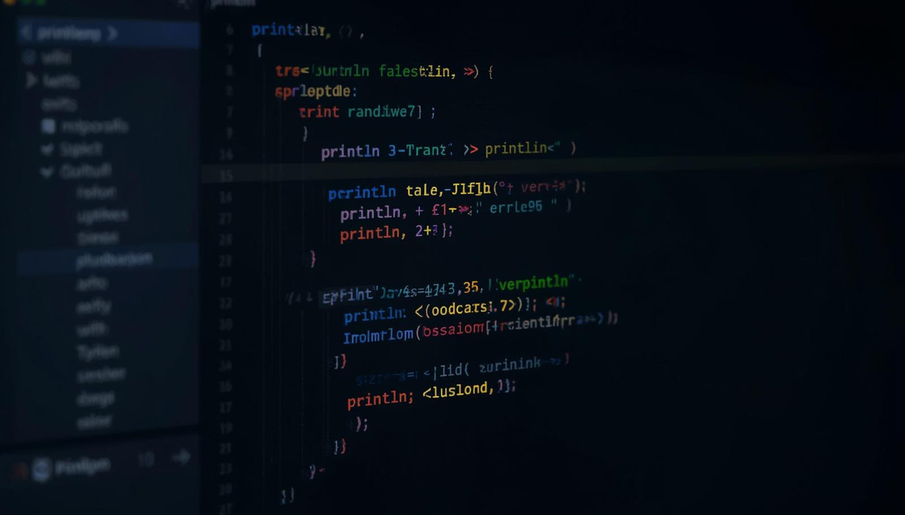
Getting Started with Java
OUTPUT AND PRINT METHODS
print() → prints text without a new line.
println() → prints text and moves to a new line.
Text must be inside double quotes ("").
Numbers don't need quotes and can be used in calculations.

Slide 10

Getting Started with Java
JAVA COMMENTS – SINGLE-LINE
Comments make code more readable and help explain the logic behind your code. They are completely ignored by the Java compiler during execution.
Single-line Comments
01
Start with // and continue to the end of the line. Example: // This is a comment
Code Example
02
// This is a comment
System.out.println("Hello World");

Slide 11




Getting Started with Java
JAVA COMMENTS – MULTI-LINE
Multi-line comments start with /* and end with */. They are useful for longer explanations or temporarily disabling blocks of code. The compiler ignores everything between these markers.
Example:
/* The code below will print Hello World
to the screen, and it is amazing */
System.out.println("Hello World");

Slide 12

Getting Started with Java
SUMMARY – KEY POINTS
Main Class & Method
01
Every Java program must have a Main class and a main() method as the entry point for execution.
System.out.println()
These essential takeaways will help you remember the fundamental concepts of Java programming as you continue your learning journey.
02
Use System.out.println() to display output to the screen. This is your primary tool for printing text and values.
Semicolon Syntax
03
Always end every Java statement with a semicolon (;). Forgetting this will cause compilation errors.
Case Sensitivity
04
Java is case-sensitive. File names must match class names exactly (e.g., Main.java for class Main).

Slide 13

Getting Started with Java
ADDITIONAL TIPS FOR BEGINNERS
Save Files Correctly
01
Always save your Java files with the .java extension and ensure the filename matches the class name exactly.
Mind Case Sensitivity
These practical tips will help reinforce your learning and build confidence as you begin your Java programming journey.
02
Pay close attention to uppercase and lowercase letters in all identifiers — MyClass and myclass are different in Java.
Practice Regularly
03
Build confidence by writing and running simple programs frequently. Hands-on practice is the best way to learn.
Comment Your Code
04
Use comments liberally to clarify your code logic. This helps you and others understand your programs better.

Slide 14
Getting Started with Java
RESOURCES AND NEXT STEPS
Explore Tutorials
Practice Coding
Join Communities
Explore Java tutorials and official documentation to deepen your understanding of core concepts and best practices.
Experiment with writing your own Java classes and methods. Hands-on practice builds confidence and reinforces learning.
Join coding communities or study groups for support. Collaboration accelerates learning and provides valuable feedback.
Visit muhammadal-bothom.netlify for more resources, tutorials, and guidance on your Java learning journey.

Slide 15



Getting Started with Java
THANK YOU FOR YOUR ATTENTION!
We hope this presentation has helped you take your first steps into the world of Java programming. Keep practicing and exploring!
+971543439118
+962799677024
m7mdbozom@gmail.com
muhammadal-bothom.netlify

