Slide 1


Muhammad AlBothom
JAVA PROGRAMMING FUNDAMENTALS
FROM SETUP TO METHODS
A Beginner's Syllabus Concepts
Presenter: Muhammad Mousa AlBothom
+971543439118 | +962799677024 | m7mdbozom@gmail.com

Slide 2


Java Programming Fundamentals
COURSE SYLLABUS OVERVIEW
Introduction & Environment Setup
01
Programming basics, Java history, installing JDK, IDE setup, and writing your first Java program.
Java Syntax & Fundamentals
This syllabus covers essential Java programming concepts from environment setup through methods, providing a solid foundation for beginners without object-oriented programming.
02
Program structure, the main() method, comments, and output statements for displaying information.
Variables & Data Types
03
Primitive and non-primitive types, declaring variables, constants, and type casting techniques.
Operators
04
Arithmetic, relational, logical, and assignment operators for performing calculations and comparisons.

Slide 3
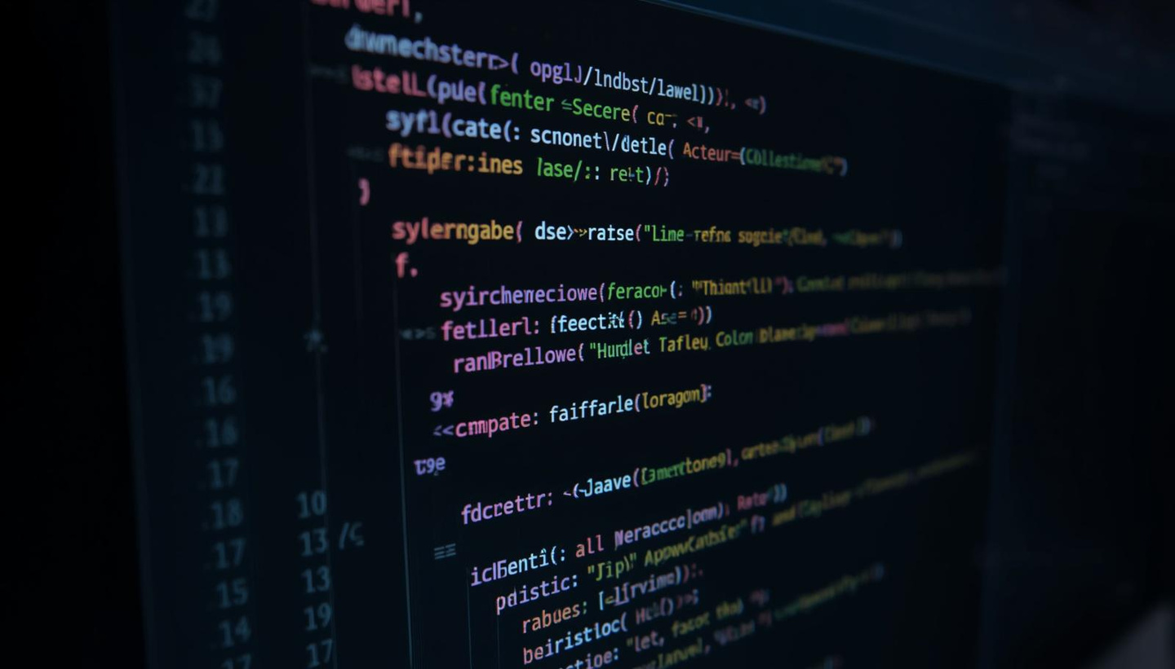
Java Programming Fundamentals
COURSE SYLLABUS OVERVIEW
Control Flow Statements
05
Conditional statements (if, switch) and loops (for, while, do-while) with break & continue keywords.
Strings & Math Classes
Continuing our journey through Java fundamentals, these modules cover essential programming constructs including control flow, data manipulation, and code organization techniques.
06
Common string methods, escape characters, Math utilities, and random number generation.
Arrays
07
Declaring, initializing, and iterating through arrays for efficient data storage and manipulation.
Methods & Mini Projects
08
Defining and calling methods, parameters, return types, overloading, plus hands-on practice projects.

Slide 4





Muhammad Mousa AlBothom
THANK YOU FOR JOINING!
Thank you for exploring Java Programming Fundamentals with us. We hope this course inspires you to continue your programming journey and master the concepts from setup to methods.
+971543439118
+962799677024
m7mdbozom@gmail.com
muhammadal-bothom.netlify

